Slide 1

Female Workforce Participation and GDP Growth

Slide 2




Danielle
Name
Chriselle Lim
Favorite Female Role Model
Toshe
Name
Audre Lorde & Michelle Obama
Favorite Female Role Model(s)
>>> The Team
Jane
Name
Michelle Obama
(copied Toshe!)
Favorite Female Role Model
Sonal
Name
Kate Middleton
Favorite Female Role Model
Notes:
All

Slide 3
Is there a correlation between Female Workforce Participation and GDP Growth?
Our project explores the relationship between female workforce participation and GDP growth from 1990 to 2018
Female Workforce Participation
Female workforce participation represents participation as a proportion of total workforce
Workforce participants are comprised of:
People ages 15 and older
Anyone who supplies labor for the production of goods and services (independently of whether they do so for pay, profit or family gain)
People who are “economically active;” those who are either employed (including part-time employment starting from one hour a week) or unemployed (including anyone looking for job)
‘Employment’ also includes self-employment
GDP Growth
GDP growth represents the annual percentage growth rate of each country’s GDP based on their local currency
>>> Research Question
Notes:
Toshe

Slide 4
Data Extraction, Transformation, and Loading
Extract
Used 4 datasets
World Bank global data on GDP growth (1961-2018)
World Bank global data on female workforce participation (1961-2018)
Comprehensive list of each country’s latitude and longitude
Comprehensive list of each country’s continent
Clean/Transform
Cleaned and standardized both world bank datasets (e.g. unpivoted columns, excluded regions and socioeconomic categories from the world bank datasets)
Added latitude and longitude to the cleaned world bank datasets
Joined world bank data with continent data using SQLAlchemy
Load
Created tables in postgreSQL
Used SQLAlchemy to create a connection between tables in pandas and SQL
Exported the final versions of the tables as CSV, JSON and GeoJSON files
>>> Data Strategy & Analysis
Notes:
Toshe

Slide 5
Visualizations
Line & Bar Charts
Used Plotly to generate graphs
Iterated through each year and calculated averages using d3
Filtered data
Grouped by continent and created arrays to hold each continent’s average values
Maps: Female Workforce Participation & GDP
Data preparation:
Converted CSV files into GeoJson files with (https://www.convertcsv.com/csv-to-geojson.htm)
Merged world bank data geojson with countries and continent data geojson with python script.
Converted geojson data files to geo.js format to plot choropleth Maps.
Mapping
Generate an interactive Choropleth map with Leaflet
Called L.geojson() function to display data in the form of a choropleth map
Set up 2 base layers of different styles, 6 over layers to display data by continent
Utilized sequential color scheme to demonstrate a range of values
Created a time slider to filter out data by year
Used popups to attach more information
Embedded zoom in and zoom out functions
>>> Data Strategy & Analysis
Notes:
Jane&Toshe -- Sonal&Danielle

Slide 6
HTML and CSS
HTML
Found design inspiration:
Prior projects (e.g., Christian’s), Bootstrap templates
Imagery supporting our “wonder women” female theme/hypothesis (Int’l Women’s Day)
Best source: Shutterstock (purchased royalty-free background images)
Researched the designer/illustrator, who provided a specific color scheme
Created basic DOM
Utilized Bootstrap 4 for website layout, elements
Set classes to ensure scalability/responsiveness for all browser types (desktop vs. mobile)
CSS
Customized specific class properties (e.g., font, Hex color values)
Set Z-Indexes to properly layer elements front-to-back (e.g., text box vs. background image)
Merged code with collaborators
Inserted necessary scripts and JavaScript file references for visualizations
Created proper directory structure and updated paths throughout code
Set up Flask server
Created MongoDB cluster & collection
Imported data
Adjusted url references in HTML
>>> Web Design
Notes:
Jane

Slide 7
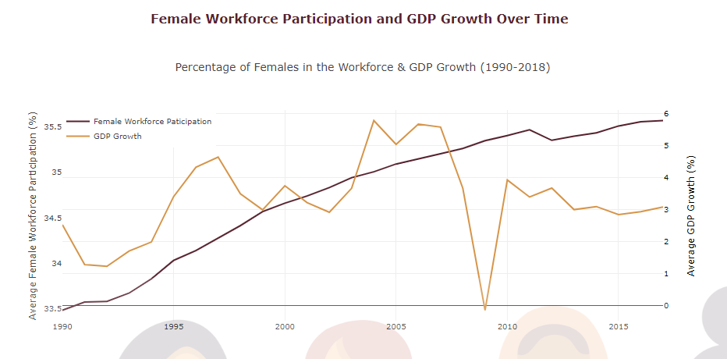
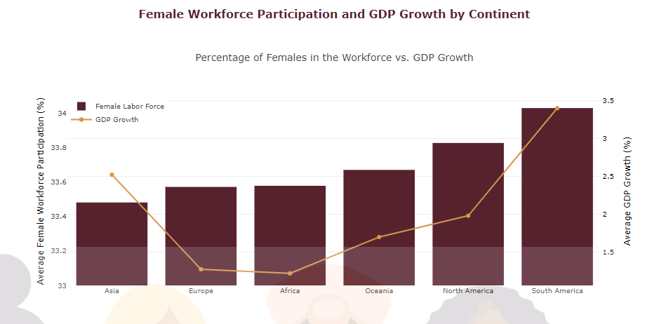
Female Workforce Participation and GDP Growth Overtime and by Continent
>>> Findings
Female workforce participation grows steadily, with an annual percentage growth rate of 2.2%
Female workforce participation has a 6.2% percentage change from 1990 to 2018
GDP growth is far more volatile, with major declines in growth in the early 1990’s, the early 2000’s and 2009 due to domestic and global recessions and economic downturns
Female workforce participation varies considerably across continents
Countries in South America have seen the biggest gains in female participation since 1990; women with high education levels are working more, and in some countries, women have surpassed men in educational attainment
Starting in 1978, China and other “Asian Tigers” started investing heavily in their capital (factories, machinery, better technology and communications systems), and in educating their workforce. All of this made the countries more productive and increased their output and GDP
Notes:
WEBSITE: Jane&Toshe

Slide 8
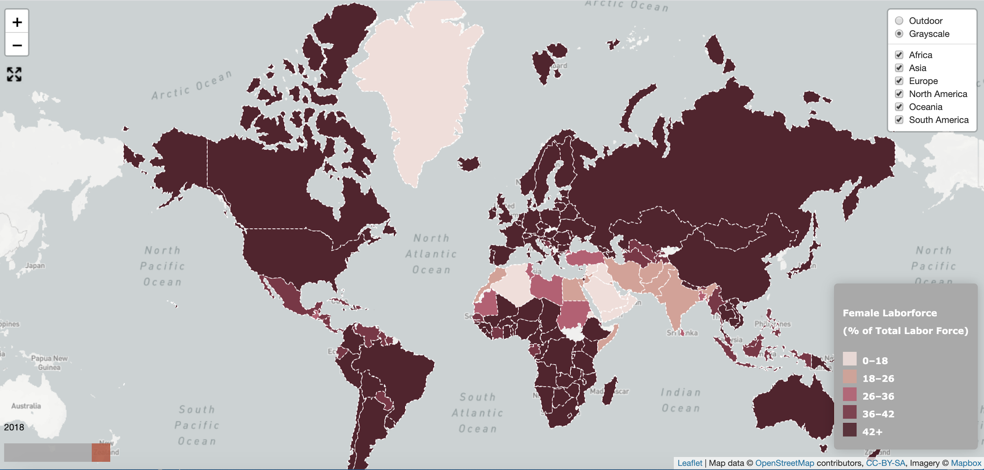
Female Workforce Participation(1990-2018)
The following choropleth map visualization shows female workforce participation across world regions
By clicking on a country we can see the female workforce participation percentage for that specific country
We can also see the change over time by using the time slider at the bottom left corner
This map represents data from 1990 to 2018
>>> Findings
The Choropleth map shows female workforce participation rate across the world from 1990 to 2018.
As can be seen, in 1990, a group of middles east countries along with Algeria in Africa had less than 18 percentage of women participating in the workforce.
In the 90s, we can see discernible growth in female workforce participation in North American, South American, Western European countries.
During 2000 - 2010, among the developing middle east countries, Iran, Pakistan, India female participation grew above 18%.
During 2010-2018, on the map, the change in shades of color can be observed in countries in Middle East , South America, and North Africa.
Notes:
WEBSITE: Danielle

Slide 9
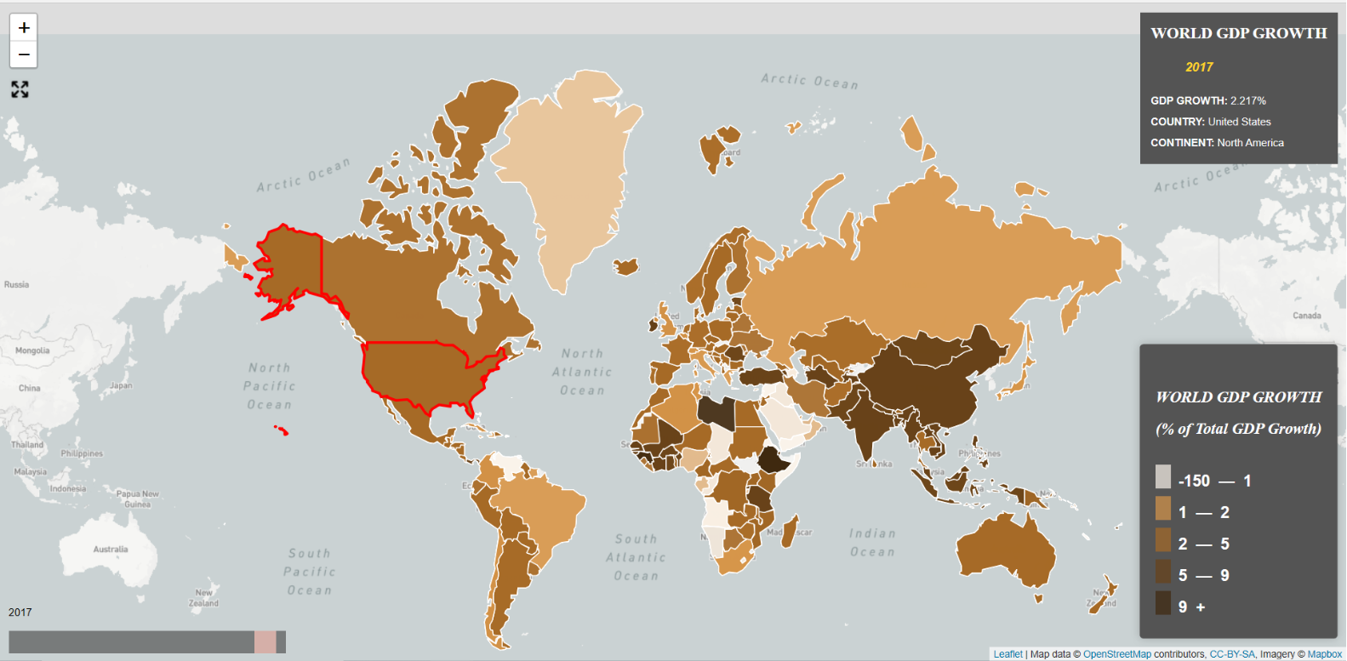
Global GDP Growth (1900-2018)
The following choropleth map visualization shows GDP growth across world regions
By clicking on a country we can see the GDP data/growth for that specific country
We can also see the change over time by using the time slider at the bottom left corner
This map represents data from 1990 to 2018
>>> Findings
While GDP(economic development) tends to increase with women’s labor force participation, the relationship is not straightforward or consistent at the country level.
In USA , we see an increasing trend of GDP growth with Female labor participation since 1990 , but if we consider The Great Recession (2007-09) trend, in 2009 the GDP has gone negative with female participation being same or increasing.
For USA in 2017 the GDP has increased to 2.2% with female participation remaining same around 46%
Notes:
WEBSITE :SONAL

Slide 10
Summary
Female workforce participation has increased steadily at a rate of 2.2%, and a 6.2% percentage change from 1990 to 2018
Only ~36% of the total workforce is female, which means a significant amount of women’s productive potential still remains untapped, and women are still an underutilized labor resource
Global GDP has also grown substantially throughout the decades. However factors such as depressions and recessions produce rapid declines in global GDP growth in select years
Women’s labor force participation and GDP growth vary across countries and continents
There are several factors that contribute to GDP growth. While there is no direct line between female workforce participation growth and GDP growth, it is a well known fact that high female workforce participation leads to an increase in workforce activity, and an increase in workforce activity inevitably leads to economic growth
>>> Findings
Notes:
WEBSITE: (Landing page talk through) Toshe & Jane

Slide 11

THANK YOU

